Slide 1
Java Quiz App
A GUI-Based Student Quiz System Developed with Java swing ,MySQL, JDBC

Slide 2









Team:-
TEEN TITANS
FARDEEN KHAN
GROUP LEADER
GU Mail I’d : fardeen.24sece1290012@galgotiasuniversity.ac.in
ADMISSION NO. : 24SECE1290012
AKSHAT TRIVEDI
GROUP MEMBER
GU Mail I’d : akshat.24sece1290008@galgotiasuniversity.ac.in
ADMISSION NO. : 24SECE1290008
GARV SAXENA
GROUP MEMBER
GU Mail I’d : garv.24sece1290030@galgotiasuniversity.ac.in
ADMISSION NO. : 24SECE1290030
RAYYAN ALI KHAN
GROUP MEMBER
GU Mail I’d : rayyaan.24sece1290027@galgotiasuniversity.ac.in
ADMISSION NO. : 24SECE1290027

Slide 3
Project Overview
This project is a Java-based desktop application that allows students to take a quiz through a user-friendly Swing GUI. The application collects student information (name, roll number, course), fetches questions from a MySQL database, evaluates answers, provides instant feedback and grading, and stores the results for teachers to review.

Slide 4

Technologies Used
The project employs multiple technologies to ensure efficiency and performance:
Java (JDK 17+) for robust application development.
Swing as the UI framework for creating dynamic interfaces.
JDBC for seamless database connectivity allowing interaction with MySQL.
MySQL database management system for storing user data and quiz questions.
Eclipse IDE
GitHub for version control

Slide 5
Objective of the Project
The primary goal of the Java Quiz App is to provide a structured system that allows students to take quizzes with ease.
- Capturing student details prior to the quiz.
- Presenting multiple-choice questions fetched from a MySQL database.
- Automatically grading student performance and providing instant feedback by storing quiz results in the database.

Slide 6
Project Structure
The project is organized into multiple directories to ensure clarity and separation of concerns:
src/ folder contains all source code.
ui/ directory houses GUI classes responsible for interface elements.
dao/ folder includes data access objects for database operations.
model/ contains POJO models that represent data.
utilities/ folder for handling database connections.
Additionally, the quizguvi.sql script provides the database structure and data.
README.md , .gitsignore , .pptx

Slide 7

Database Schema
The database schema is designed to efficiently store and retrieve relevant information:
- Table: students consists of fields such as student_id (PK), name, roll_no, and course_name.
- Table: questions includes id (PK), question_text, options, and correct_answer.
- Table: quiz_results contains result_id (PK), student_id (FK), score, grade, and timestamp to track quiz performance.

Slide 8
Code Quality & Modularity
The application follows best practices in code quality and design:
- It employs the Model-View-Controller (MVC) architecture to separate concerns.
- The DBConnection.java file centralizes database logic, promoting reusability.
- DAO classes are designed for managing data access effectively.
- All Java files are well-commented to enhance maintainability and readability.

Slide 9
User Interface Design
The user interface is constructed to facilitate an engaging experience while maintaining clarity. It features a student information form to capture necessary details such as name, roll number, and course. The quiz window is designed to focus on the quiz experience, displaying multiple-choice questions in an organized manner. The interface also includes a feedback pop-up to inform students of their scores in a user-friendly format.

Slide 10

UI/UX Features
The application includes several UI/UX features that enhance usability and responsiveness:
- A responsive layout created using Java Swing ensures adaptability across different screen sizes.
- Font styling and proper spacing contribute to readability, making the quiz visually appealing.
- Options selected by students undergo validation checks, ensuring accurate quiz input.
- Final scores and feedback are presented through pop-up dialogs, enhancing user interaction.

Slide 11
Error Handling & Robustness
To ensure a smooth user experience, the application incorporates robust error handling mechanisms:
Input validation is enforced to prevent erroneous data entry.
The application is equipped to handle SQL failures gracefully, providing users with informative feedback.
GUI feedback is provided for scenarios where no answer is selected, guiding students towards making appropriate selections.

Slide 12
Grade Calculation Logic
The grading system evaluates student performance based on their percentage of correct answers:
Scores of 90% or above are classified as Outstanding.
Scores between 75% and 89% are rated as Very Good.
Scores from 60% to 74% are considered Average.
Scores between 40% and 59% indicate Below Average performance.
Scores falling below 40% are categorized as Fail, allowing for appropriate feedback.

Slide 13







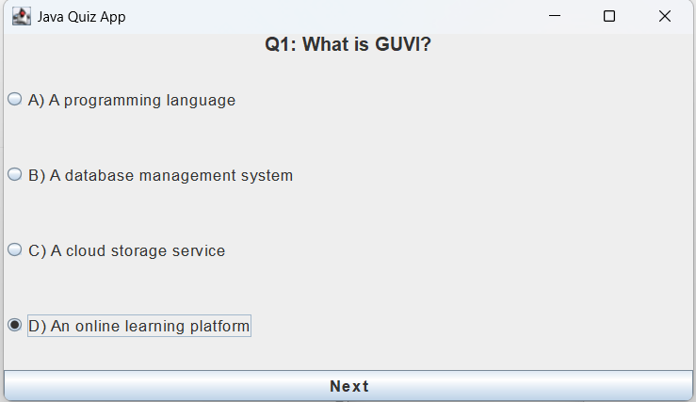
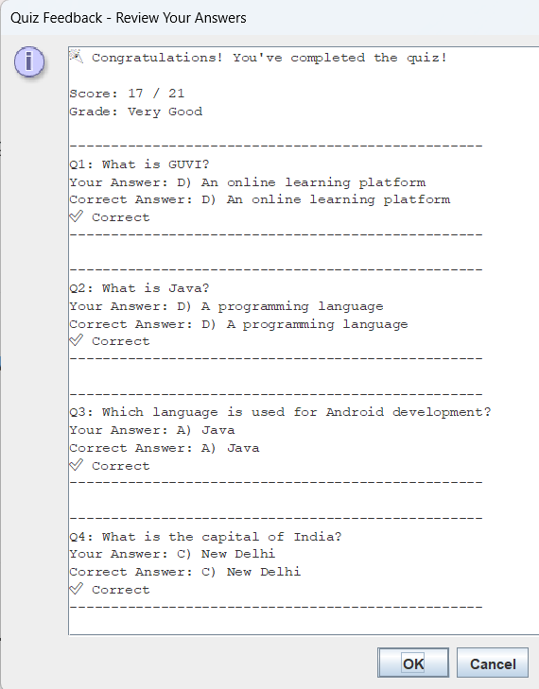
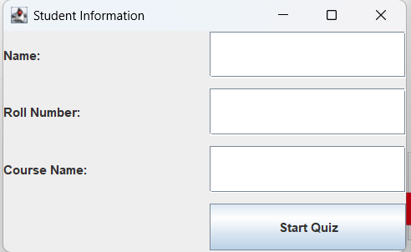

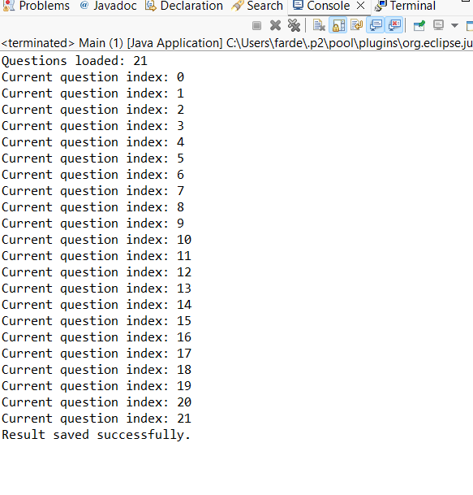
Sample Quiz Output :-
1) Screenshot: Quiz running:-
2) Screenshot: Student info form:-
3) Screenshot: Score popup:-

Slide 14

Student Feedback Mechanism
The application includes mechanisms to gather and present student feedback:
- After quiz completion, students receive an evaluation of their performance, allowing them to identify areas for improvement.
- The feedback mechanism is designed to motivate continuous learning and engagement, thereby enhancing the educational experience.

Slide 15
GitHub Repository Overview
Link: https://github.com/FARDEEN1KHAN9
Public with:
Full source code
README
Database script
Presentation PPT

Slide 16
Conclusions
In summary, the Java Quiz App is an effective tool for gauging student knowledge through an intuitive interface and structured methodology. The combination of robust technology, elegant design, and performance assessment strategies ensures a high-quality user experience. The project meets all predefined criteria for Review 1 and positions itself for further enhancements and evaluations.

